Slide 1
Uteruses Owned by the State: Mo Yan’s Fiction about the One-Child Policy
Shelley W. Chan
Wittenberg University

Slide 2
China’s One-Child Policy
Families were encouraged to have more children due to Mao Zedong’s (1893-1976) belief that population growth would empower the country;
Life expectancy increased dramatically in the three decades after the People’s Republic was established (35/40--65/ years old);
Mortality rate largely decreased: 20 per thousand in 1949--6.21 per thousand in 1979;
Efforts of experts on population ignored
  --Ma Yinchu’s (1882-1982) “New Population Theory” (1957) was openly attacked, and Ma was removed from the position of the president of Peking University.
Population growth beyond control: encouraged more birth than they could support.
One-child policy was implemented nationwide in 1979 (allowed exceptions)

Slide 3
China’s One-Child Policy (cont.)
Fines;
Pressures to abort pregnancy;
Forced abortion; induction of labor;
Abandonment and infanticide occurred to female infants;
Imbalance of sexes (about 114 males to 100 females);
“4-2-1 structure”;
Siblingless generation;
Aging population;
Shidu parents;
Transnational adoption;
November 2013 the government relaxed the policy, allowing families to have two children if at least one parent is from a one-child family.
October 2015, One-Child Policy was replaced by Two-Child Policy.

Slide 4
Mo Yan
Born in 1955 into a peasant’s family in Northeast Gaomi Township, Shandong Province, China
Name Mo Yan (莫言)—“don’t speak” (real name: Guan Moye管谟业）
A self-educated writer—a 5th grader
Motivation of becoming a writer: hunger
Enlisted in 1976; served in the army for over 20 years
Influenced/inspired by American writer William Faulkner, Columbian writer García Márquez, and Chinese writer Lu Xun, etc.
Winner of the Nobel Prize in Literature in 2012: a writer “who with hallucinatory realism merges folk tales, history and the contemporary.”

Slide 5
Mo Yan’s Works
Eleven Novels:
The Red Sorghum Family (1987)
The Garlic Ballads (1988)
Thirteen Steps (1989)
The Republic of Wine (1992)
The Herbivorous Family (1994)
Big Breasts and Wide Hips (1996)
Red Grove (1999)
Sandalwood Death (2001)
Pow! (2003)
Life and Death are Wearing Me Out (2006)
Frog (2009)

Slide 6
Mo Yan’s Works (cont.)
A large corpus of novellas and short stories
Eight of his novels were translated into English by Howard Goldblatt
His works have been translated into many other languages, including French, German, Italian, Spanish, Japanese, Korean, and Vietnamese
The film Red Sorghum, directed by Zhang Yimou and based on the first two chapters of The Red Sorghum Family, won the Golden Bear Award at the 1988 Berlin International Film Festival

Slide 7
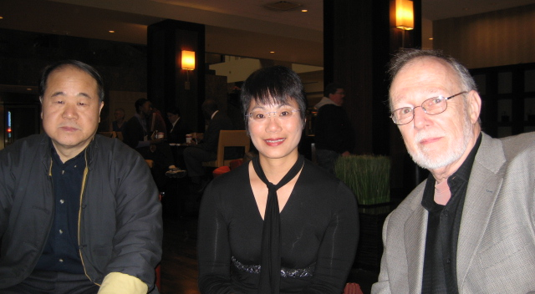
With Mo Yan and Howard Goldblatt

Slide 8
Mo Yan’s Writing about the One-Child Policy (cont.)
“Abandoned Child”
--“Doctors and the Township Government can work in concert to force sterilization upon men and women of child-bearing age, but where might we find a wonder drug capable of uprooting and eliminating the petrified notions that cleave to the brains of people in my hometown?”
(Howard Goldblatt’s translation)
“Tunnel”
--“My dear wife, we won!”

Slide 9
Mo Yan’s Writing about the One-Child Policy
“Explosions”
--“A daughter is not a son… Daughters don’t count; women aren’t people.”
--“I ache to become that fetus. I see myself and shudder with terrible, uncontrollable fear… I am pushing a heavily laden cart up the mountain. The mountain path twists and turns, precipitous. I brace myself, planting my legs firmly, the muscles feel as if they’re going to split. I grasp the cart handles in both hands, shut my eyes and grit my teeth. My cheeks straining and puffing, I suck all my pent-up breath into my belly; things go white then black before my eyes, the ends of my hair crackle, the wooden cart handles grow, the sun spins around my head and cries of cicadas fill the air… The cart wheels roll along by inches. Push! Push hard! Harder! Just a little way now and we’ll be at the top… Put some muscle into it! Yes, that’s right, that’s right…oh, no…I can’t make it…”

Slide 10
Mo Yan’s Writing about the One-Child Policy (cont.)
“Explosions” (cont.)
--“I push the cart up the mountain, each and every muscle slack as a worn-out spring. I’m not straining my muscles, I’m straining my frame, my teeth, my porridge-thick consciousness. The distance from the slope to the mountain top is short and thin as a knife-edge. I feel the brink of the flat summit through the cart-wheels. I smell the raw scent of the wild grass and flowers. The honeybee’s golden down-covered bodies attack the gently drifting butterflies like whistling bullets…”
(Janice Wickeri’s translation)

Slide 11
Mo Yan’s Writing about the One-Child Policy (cont.)
Frog
--“I see it as a work of self-criticism… I’m guilty… I even asked my wife to have an abortion for the sake of my own future.”
--“As a father, I have always felt that everybody should have as many children as he likes. As an officer, however, I had to obey the rule which applies to every official: one child, no more. China’s population issue is not solved easily. I am sure of one thing only: Nobody must be stopped from having a child by means of violence.” (Interview with Der Spiegel, 2/26/2013)
--wa: 蛙，娲，娃
--Gugu pulled the chain on a hundred-watt bulb near the wall, bringing the room into sharp focus. Every window in the three rooms was bricked up. Latticed wooden racks fronted the eastern, southern, and northern walls, each little square occupied by a clay doll.
--Gugu placed the doll in her hands into the last square on the wall, then stepped back, lit three sticks of incense on an altar in the centre of the room, fell to her knees, brought her palms together, and muttered prayerfully.

Slide 12
Mo Yan’s Writing about the One-Child Policy (cont.)
Frog (cont.)
--“Every child is unique and irreplaceable. Is it true that blood on one’s hands can never be washed away? Is it true that those souls haunted by a sense of guilt can never be freed?”
--“Even though she’s expressed remorse more frequently in recent years, saying she had blood on her hands, that’s history, and history is all about effects, not what caused them.”

